Slide 1
C♯ Design Patterns in Practice
Rasmus Lystrøm
Associate Professor
ITU
rnie@itu.dk

Slide 2
Agenda
Gilded Rose recap
Design Patterns

Slide 3

Gilded Rose
Demo

Slide 4
Code Metrics (Visual Studio Proper)
Maintainability Index
Between 0 and 100. Higher is better. Aim for higher than 20
Cyclomatic Complexity
Lower is better. Split methods with complexity > 10
Depth of Inheritance
Between 1 and infinity
Lower is better, but sometimes inheritance is good
Class Coupling
Lower is better. Aim for max 9
Lines of Code
https://docs.microsoft.com/en-us/visualstudio/code-quality/code-metrics-values

Slide 5
Code Metrics - Original
 | Maintainability Index | Cyclomatic Complexity | Depth of Inheritance | Class Coupling | Lines of Code
Program | 57 | 3 | 1 | 5 | 49
GildedRose | 54 | 20 | 1 | 2 | 85
Item | 100 | 6 | 1 | 0 | 6
Total | 70 | 29 | 1 | 5 | 151

Slide 6
Approach
Understand the task at hand – inspect the code
Write tests to ensure the program works to specification
Refactor, refactor, refactor
Extract methods
Implement Conjured
Refactor, refactor, refactor
Introduce polymorphism

Slide 7
Code Metrics – Polymorphed
 | Maintainability Index | Cyclomatic Complexity | Depth of Inheritance | Class Coupling | Lines of Code
Program | 57 | 3 | 1 | 8 | 33
GildedRose | 93 | 2 | 1 | 5 | 14
Item | 91 | 8 | 1 | 1 | 19
AgedBrie | 71 | 2 | 2 | 2 | 15
BackstageP. | 64 | 4 | 2 | 2 | 23
Conjured | 71 | 2 | 2 | 2 | 15
Sulfuras | 100 | 1 | 2 | 1 | 6
Total | 78 | 22 | 2 | 13 | 152

Slide 8
Cyclomatic Complexity

Slide 9
Design Patterns in Practice

Slide 10
Design Patterns
IoC Container
Builder
Adapter
Factory Method
Singleton
Iterator
Façade
Chain of Responsibility
Strategy
Bridge
Saved for later:
Command (MVVM)
Observer (MVVM)
Proxy (Web API)

Slide 11
IoC Container
Tool to facilitate dependency injection.
Using a factory to either manually or automatically create types at runtime.
Various implementations:
Microsoft.Extensions.DependencyInjection
Ninject
Unity
AutoFac
StructureMap

Slide 12
IoC Container II
Lifetime:
Transient
Scoped
Singleton
Lifetime:
Transient (every time)
Scoped (once per request)
Singleton (once)

Slide 13
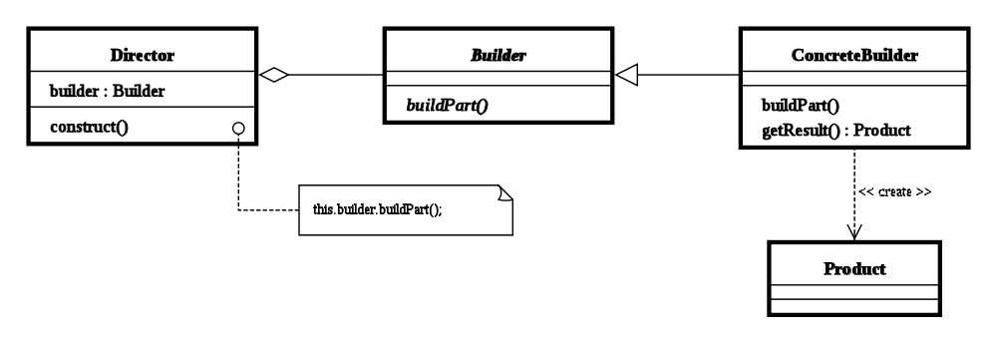
Builder
Separate the construction of a complex object from its representation
serviceCollection.AddScoped<,>();
serviceCollection.BuildServiceProvider();

Slide 14
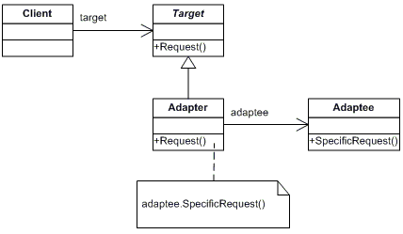
Adapter aka Wrapper
Unmodifiable implementation which does not match the interface you need.
Static or sealed class or class in another assembly.

Slide 15
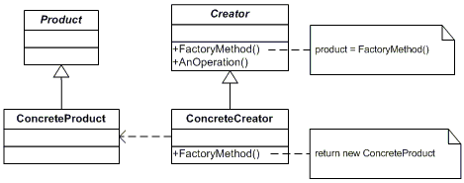
Factory Method
A method which can creates instances of a given type.

Slide 16
Singleton
Only ever one single instance of a given type.
Considered an anti-pattern by many, it:
is overused
introduces unnecessary restrictions in situations where a sole instance of a class is not actually required
introduces global state into an application

Slide 17

Singleton II
Use carefully
Implement using an interface
Use an IoC container

Slide 18
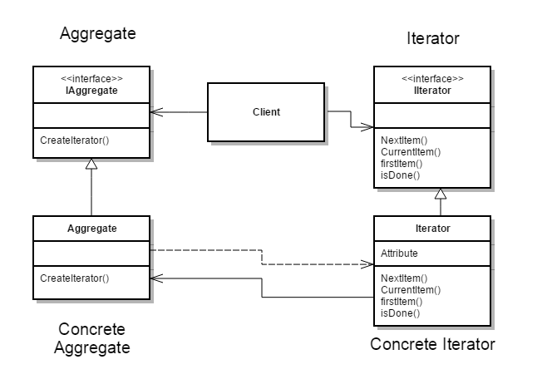
Iterator
Provide a way to access the elements of an aggregate object (collection) sequentially without exposing the underlying representation
IEnumerable
IEnumerable<T>
IEnumerator
IEnumerator<T>
foreach...

Slide 19
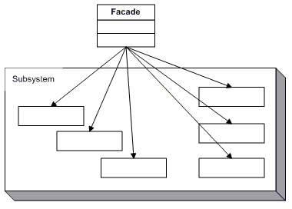
Façade
Simplify the use of a system
Provide a uniﬁed interfaces for a group of “dispersed” functionalities from a multitude of interfaces/classes

Slide 20
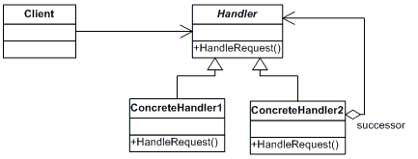
Chain of Responsibility
Avoid coupling the sender of a request to its receiver by giving more than one object a chance to handle the request. Chain the receiving objects and pass the request along the chain until an object handles it.

Slide 21
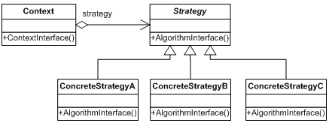
Strategy
Define a family of algorithms, encapsulate each one, and make them interchangeable. Strategy lets the algorithm vary independently from clients that use it.

Slide 22
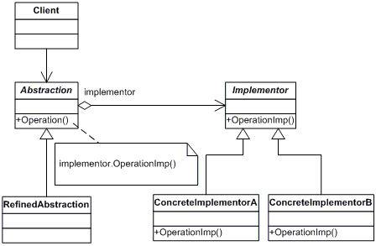
Bridge
Decouple an abstraction from its implementation so that the two can vary independently.

